Slide 1

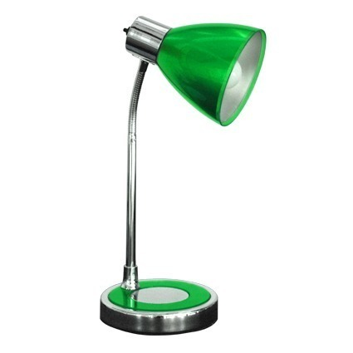
The Financial Secrecy Index
Shedding light on global financial secrecy
Andrés Knobel – andres@taxjustice.net
The FACT Coalition – Washington D.C., November 2nd, 2015

Slide 2

WHY THE FSI?
TAX HAVEN LISTS | FSI
TAX HAVEN | SECRECY JURISDICTION
TAX RATE / (Weak) OECD Standards | SECRECY
INCONSISTENCY & USUAL EXCLUSIONS | 60-> 73-> 82 -> 102-> … ALL JURISDICTIONS
only SMALL PALMED ISLANDS | OECD COUNTRIES TOO!
POLITICAL PRESSURE | OBJECTIVE & VERIFIABLE
BLACKLIST / WHITELIST | SPECTRUM
YES/NO | DEGREE
CLARIFY THE REAL ISSUES
IDENTIFY THOSE ACTUALLY RESPONSIBLE
MONITOR & PUSH FOR EFFECTIVE MEASURES

Slide 3
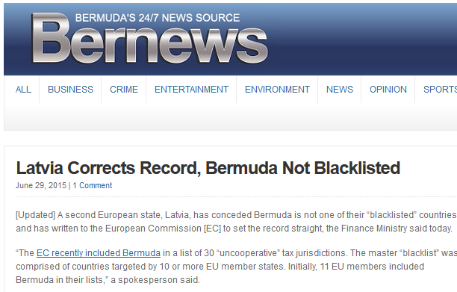

Slide 4
WHY THE FSI?
TAX HAVEN LISTS | FSI
TAX HAVEN | SECRECY JURISDICTION
TAX RATE / (Weak) OECD Standards | SECRECY
INCONSISTENCY & USUAL EXCLUSIONS | 60-> 73-> 82 -> 102-> … ALL JURISDICTIONS
only SMALL PALMED ISLANDS | OECD COUNTRIES TOO!
POLITICAL PRESSURE | OBJECTIVE & VERIFIABLE
BLACKLIST / WHITELIST | SPECTRUM
YES/NO | DEGREE
CLARIFY THE REAL ISSUES
IDENTIFY THOSE ACTUALLY RESPONSIBLE
MONITOR & PUSH FOR EFFECTIVE MEASURES

Slide 5
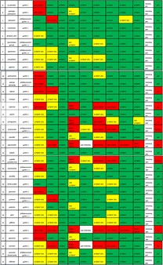
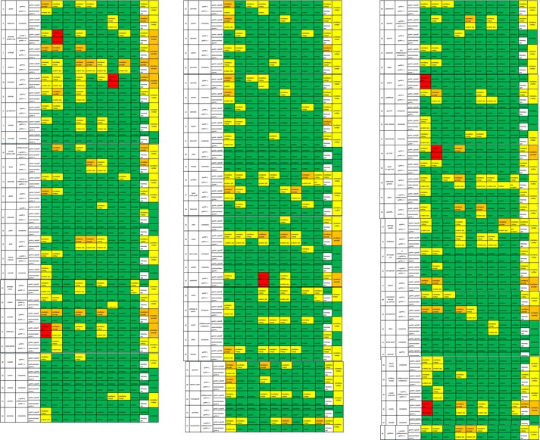
Global Transparency (as of Oct 2015) according to
OECD’s Global Forum: The Job is practically done!
LEGAL FRAMEWORK
LEGAL FRAMEWORK & IN PRACTICE
No: 8 out of 34 jurisdictions
(Micronesia, Guatemala, Kazakhstan, Lebanon, Liberia, Nauru, Trinidad & Tobago, Vanuatu)
Partially Compliant: 12 out of 86 jurisdictions
(Andorra, Anguilla, Antigua & Barbuda, Barbados, Costa Rica, Curacao, Indonesia, Israel, St. Lucia, Samoa, St . Maarten, Turkey)

Slide 6
FSI STRUCTURE
HOW MUCH OPACITY EACH JURISDICTION OFFERS TO NON-RESIDENTS (TO ALLOW THEM TO ESCAPE/UNDERMINE LAWS, RULES, TAXES, ETC. ABROAD), WEIGHTED BY THE JURISDICTION’S MARKET SHARE OF FINANCIAL SERVICES FOR NON-RESIDENTS (based on IMF’s Zoromé 2007)
SECRECY SCORE
GLOBAL SCALE WEIGHT
How Secretive?
How much Market share?
Moderately secretive
31-40
WEIGHTED BY
41-50
huge
51-60
61-70
71-80
large
81-90
small
Exceptionally secretive
91-100
tiny

Slide 7
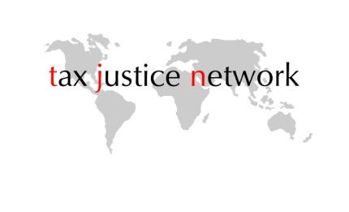
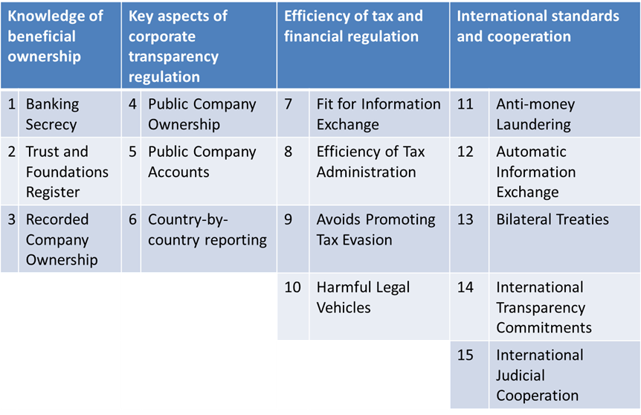
SECRECY SCORE
Lowest available transparency denominator!!

Slide 8

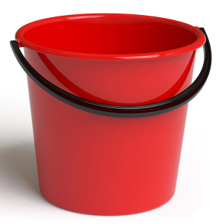


WHOSE SECRECY PROVISIONS
POSE BIGGER RISK?

Slide 9

FSI 2015 RESULTS: TOP 10
Ranking | FSI
1 | Switzerland
2 | Hong Kong
3 | USA
4 | Singapore
5 | Cayman Islands
6 | Luxembourg
7 | Lebanon
8 | Germany
9 | Bahrein
10 | Dubai / UAE
Average of SS | 68.0
Sum of GSW | 56.5%
Secrecy Score | Global Scale Weight
Vanuatu | United States
Samoa | United Kingdom
Liberia | Luxembourg
St. Lucia | Germany
Brunei Darussalam | Switzerland
Antigua & Barbuda | Cayman Islands
Lebanon | Singapore
Marshall Islands | Hong Kong S.A.R.
Bahamas | France
Belize | Ireland
81.9 | 57.4
0.5% | 78.7%
FSI
TAX HAVEN LISTS

Slide 10
WHAT IS THE FSI?
1) RANKING of the World’s biggest contributors of Financial Secrecy

Slide 11
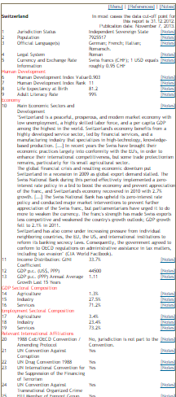
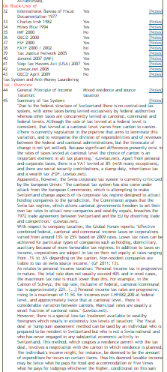
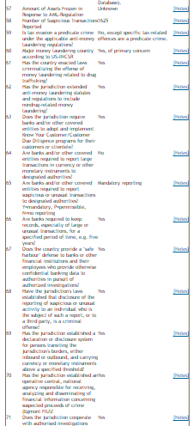
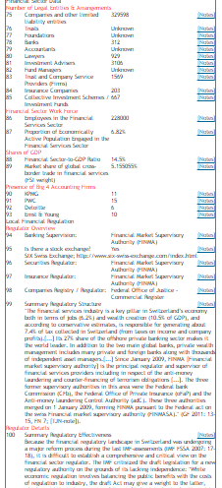
WHAT IS THE FSI?
2) DETAILED REPORTS on more than 100 jurisdiction’s legal framework regarding banking secrecy; ownership registration of companies, trusts, foundations; compliance with AML, CbCR, and many more…
From December 2015

Slide 12
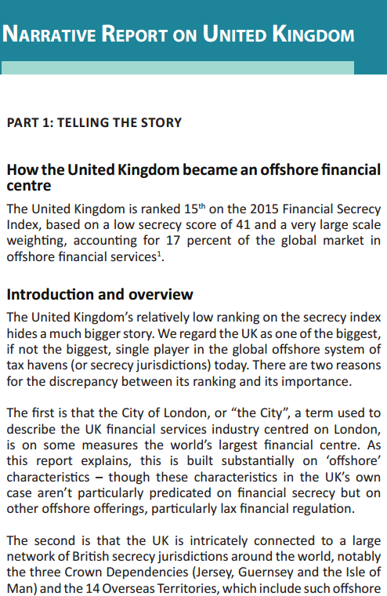
WHAT IS THE FSI?
3) NARRATIVE REPORTS for FSI’s Top Jurisdictions and other tax havens

Slide 13
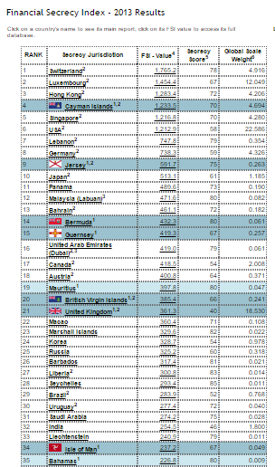
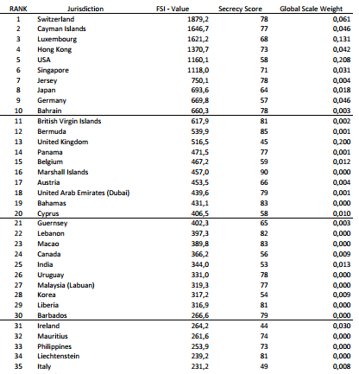
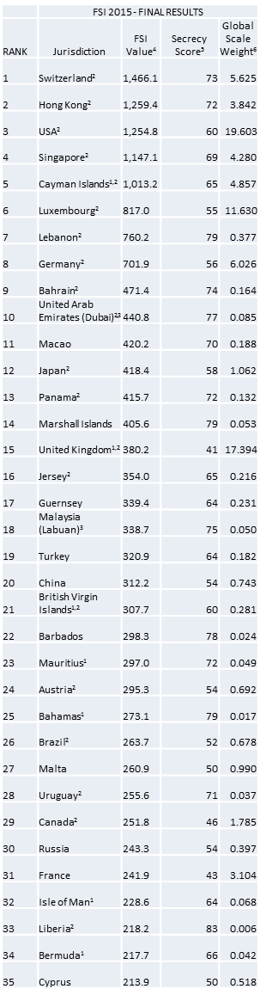
Allows identifying risks & tracking progress or deterioration (in relative terms) of jurisdictions’ transparency frameworks
FSI 2011
FSI 2013
FSI 2015

Slide 14

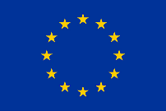
THE U.S.
A BIG LAGGARD RELATIVE TO MOST FINANCIAL CENTRES!
NO BENEFICIAL OWNERSHIP REGISTRATION vs
FOR COMPANIES
NO COUNTRY-BY-COUNTRY REPORTING vs
(CbCR) FOR BANKING & EXTRACTIVES
NO MULTILATERAL AUTOMATIC
INFORMATION EXCHANGE (OECD’s CRS) vs 91 Jurisdictions!
Ranking | FSI
1
2
3 | USA
4
5
6
SS = 60
GSW = 19.6%

Slide 15
WHO USES THE FSI’s
RANKING & DETAILED COUNTRY-REPORTS?
(at least those we are aware of)
- NGOs & Activists
- Journalists
- Researchers
- Tax Authorities (for ownership registries, evasion schemes and investigations)
- Law-Enforcement Agencies (to support prosecutions & financial-crimes investigations)
- Banking Supervisors & FIUs (AML risks regarding jurisdiction’s types of legal entities)

Slide 16


THANK YOU!
More Information:
http://www.financialsecrecyindex.com
http://taxjustice.net
http://treasureislands.org/
andres@taxjustice.net

